Slide 1
Alabama Water Policy Symposium: State-wide water plans and the Clean Water Act
Jim Giattina, Director
U.S. EPA Region 4
Water Protection Division
May 10, 2013

Slide 2
Water Issues in the Southeast
Emerging issues in balancing freshwater flows

Slide 3
Hydrologic Alteration in the Southeast
Dams/
Impoundments
Withdrawals
Surface Water
Ground Water
Storm Water
Channelization

Slide 4
Need to balance freshwater flow needs:
Industrial
Process water
Cooling water
Power generation
Hydropower
Nuclear
Coal
Fracking
Agriculture
Municipal water users
Drinking water
Residential
Commercial

Slide 5
Balancing freshwater needs (con’t):
Recreation
Navigation
Aquatic Life
Fishing
NPDES discharge waste assimilation for municipal and industrial facilities.
Freshwater to support healthy estuaries and shell fish harvesting.

Slide 6
Increased competition results in:
Increase in hydrologic alterations in already highly altered ecosystems
Increase in applications for reservoirs
Increase in withdrawals from ground water
Requests for inter-basin transfers
Water wars and litigation between states
Litigation over FERC licenses and 401 Certs
Concern and potential litigation from NGOs, municipalities and industrial facilities

Slide 7
New studies are defining the ecological impacts of hydrologic alteration.
“Human influence on watershed hydrology is extensive and…
…may be the primary cause of ecological impairment in river and stream ecosystems.”
Carlisle, Wolock and Meador, 2010
U.S.G.S.

Slide 8
Environmental Consequences of Hydrologic Alteration
Physical change examples:
Dewatering of streams
Scouring due to high flows
Chemical change examples:
Concentration of pollutants, increased nutrients, toxics.
Increase in stream temperatures, lowered DO, increased nutrients
Increased salinity (estuaries)
Biological changes examples:
Disruption of fish passages, loss of species
Impaired biological listings
Loss of sea grass
Complete loss of use

Slide 9
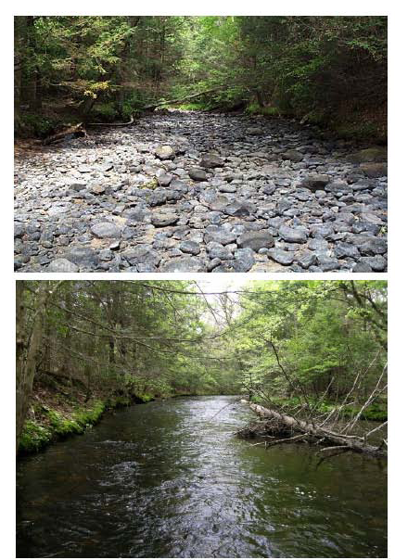

Slide 10
Studies also define economic impacts
Healthy aquatic ecosystems support outdoor tourism and recreation
6.1 million American jobs
$646 billion in outdoor recreation spending
$39.7 billion in state/local tax revenue
Healthy aquatic ecosystems provide ecosystem services
Minimizes drinking water costs
Minimizes damage from natural disasters.
Healthy bays and estuaries support 1,000’s of jobs and generate millions in revenue.

Slide 12
... the loss of recreation and conservation pools in drinking water reservoirs

Slide 13
… Emergency requests to drop dam releases below established critical low flows on regulated rivers.

Slide 14
… and a fishery resource disaster affecting 2,500 jobs
MEMORANDUM
DATE: September 6, 2012
TO: All Interested Media
FROM: Brian Burgess, Communications Director Executive Office of the Governor
RE: Request for Declaration Regarding Florida’s Oyster Harvesting Areas
Governor Rick Scott sent a letter today to the U.S. Department of Commerce, requesting a declaration of a fishery resource disaster for Florida’s oyster harvesting areas in the Gulf of Mexico, particularly those in Apalachicola Bay. After conferring with county leadership, Franklin County estimates the employment impact of the disaster to affect 2,500 jobs, including commercial oyster fishermen, processors and related coastal economies. Please see Governor Scott’s letter, below and attached, as well as Agriculture Commissioner Adam Putnam’s letter to Governor Scott and the August 2012 Oyster Resource Assessment Report for Apalachicola Bay.

Slide 15
Clean Water Act
Addressing Water Quantity and Water Quality

Slide 16
As states make decisions on water use, they must ensure that they are consistent with the CWA and its implementing regulations
Water Quality Standards
Designated Uses
Narrative/Numeric Criteria
Antidegradation
Section 401 Water Quality Certifications
Section 402 NPDES Permits
Section 404 Permits

Slide 17
Water Quality Standards protect flow in two ways
Explicitly
Implicitly
Water Quality Criteria
Narrative for flow
TN, KY, Seminole Tribe of Florida
Numeric for flow
Water Quality Criteria
DO, temperature, biological (as examples)
Designated Uses
Protect for aquatic life
Protect for biological integrity
Protect for habitat
Antidegradation

Slide 18
Tennessee has explicit narrative WQS for flow:
(3) Fish and Aquatic Life
(o) Flow – Stream or other waterbody flows shall support the fish and aquatic life criteria.
(4) Recreation
(m) Flow – Stream flows shall support recreational uses.

Slide 19
New Hampshire
"Unless the flows are caused by naturally occurring conditions, surface water quantity shall be maintained at levels adequate to protect existing and designated uses.”
These rules shall apply to any person who causes point or non-point discharges to surface waters or who undertakes hydrologic modifications, such as dam construction or water withdrawals, or who undertakes any other activity that affects the beneficial uses or the level of water quality of surface waters.

Slide 20
States should ensure that water plans are consistent with the CWA:
Ensure policies are consistent with WQS,
Protect the designated and existing uses of waterbodies,
Not cause or contribute to an exceedance of WQS,
Address flows in Section 401 certs,
Ensure that Section 402 NPDES permits are reviewed to recalculate limits if low flows change or
Ensure critical low flows are protected,
Ensure alternatives are evaluated in Section 404 permit applications, including conservation and efficiency.

Slide 21
Supreme Court links flow to WQS
PUD No. 1 of Jefferson County, et al. v. Washington Department of Ecology, 511 U.S. 700 (1994)
Supreme Court recognized Quantity/Quality relationship is part of CWA coverage as a whole
Supreme Court held:
flow may be linked to the three water quality standards components (i.e. uses, criteria, antidegradation)
a state may include specific flow requirements in CWA 401 certifications, as a proper application of state and federal antidegradation regulations

Slide 22
PUD: Allocation rights do not limit pollution controls
Petitioners argued for Supreme Court to use §§ 101(g) and 510(2) to limit federal authority. Supreme Court disagreed.
“Sections 101(g) and 510(2) preserve the authority of each State to allocate water quantity as between users; they do not limit the scope of water pollution controls that may be imposed on users who have obtained, pursuant to state law, a water allocation.”

Slide 23
Court Found Distinction Between Quantity/Quality Artificial
Petitioners in PUD argued that the CWA is only concerned with water “quality” and does not allow the regulation of water “quantity.” This is an artificial distinction.
In many cases, water quantity is closely related to water quality. A sufficient lowering of the water quantity in a waterbody could destroy all of its designated uses -- drinking water, recreation, navigation, or as a fishery.

Slide 24
Successful Approaches to Balancing Freshwater Needs
Green River
Saluda River
Michigan’s Groundwater Withdrawal Tool
Conservation and Efficiency

Slide 25
Green River
Collaborative approach between The Nature Conservancy and the Army Corps of Engineers
Changes to the filling schedule of the reservoir and downstream releases.
New minimum flows.
Improved mussel population/aquatic life.
Significant decrease to turbidity. Lower costs for drinking water treatment.
Increase revenue to marina operators/lake recreation.
Increase revenue for canoe operators downstream.
Notes:
http://www.nature.org/ourinitiatives/regions/northamerica/unitedstates/kentucky/placesweprotect/green-river.xml

Slide 26
Saluda River FERC License
Natural flow regime - seasonally variable flows as well as new minimum flows .
Increased spring flow releases to support spawning.
Enhanced flows to meet DO and other WQS.
Restoration of rare species.
Recreation flow releases for 51 days/year downstream.
Less fluctuation in the reservoir levels. Less scour.
Earlier filling of the reservoir extended the lake recreation season.
Public safety improvements.

Slide 27
Conservation and Efficiency
Florida has used DWSRF to provide water audits and leak detection. Utilities have saved by avoiding unbilled losses, and avoiding treatment and pumping costs on leaked water.
Royal City, Washington used a CW SRF loan to build a wastewater treatment plant, from which reclaimed water would augment irrigation in the summer and enhance local wetlands and lakes in the winter.
California state water districts use CW SRF loans to purchase irrigation equipment that is in turn leased to farmers to modernize operations for more efficient water use.

Slide 28
Conservation & Efficiency
Ashland, Oregon needed a new source of supply, two options being an $11 million new reservoir, or a $7.7 million pipeline project for a new river withdrawal
Instead, implemented efficiency program costing less than $1 million, including customer audits, efficiency appliance rebates, free irrigation and landscaping reviews, and revised rate structures.
Supply needs met through reduced consumption by ~16%
Avoided treatment costs for 58 million gallons of wastewater per year
Delayed need to seek additional supply by ~three decades

Slide 29
Conservation & Efficiency
DW State Revolving Fund supported Pennsylvania program to conduct water audits and leak detection for small systems.
Saved over 1.4 billion gallons of water and $1.36 million annually
Average lost water reduced from 36% to 9%
A tiered pricing system adopted by Greensboro, North Carolina in 2000 was able to reduce average household consumption by 22 percent in seven years.

Slide 30
Michigan’s Groundwater Withdrawal Tool
Internet Based Permitting Tool for surface and ground water.
Developed collaboratively with multiple state agencies.
Based on scientific evaluation of ecological impacts to rivers and streams.
Reduces the permitting burden while allowing for collection of data for resource management.
Majority of applications are processed within minutes.
Notes:
http://www.miwwat.org/start.asp

Slide 31
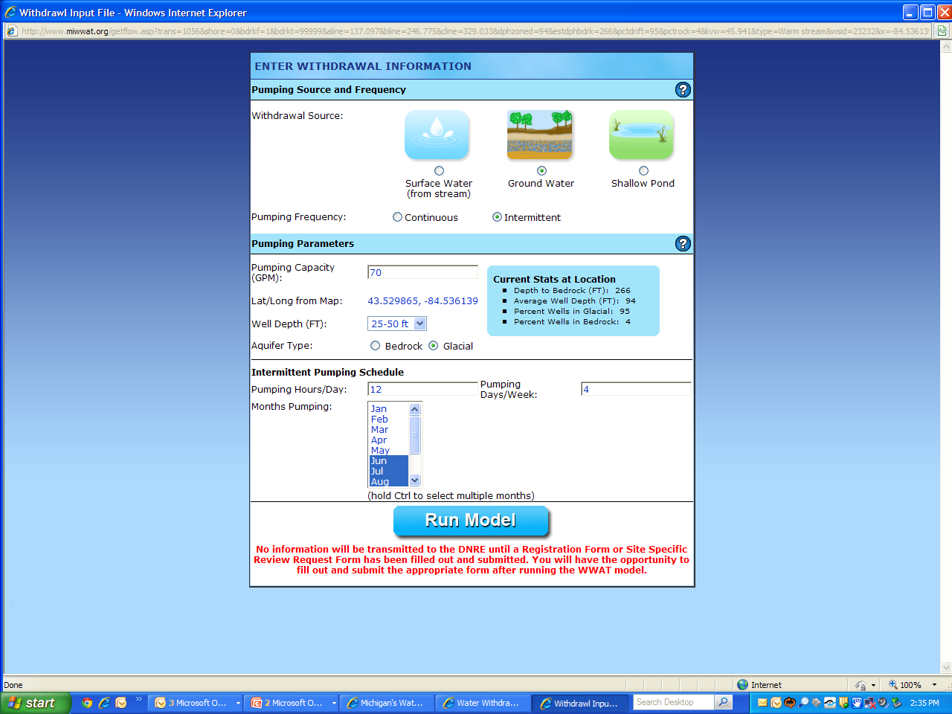

Slide 32
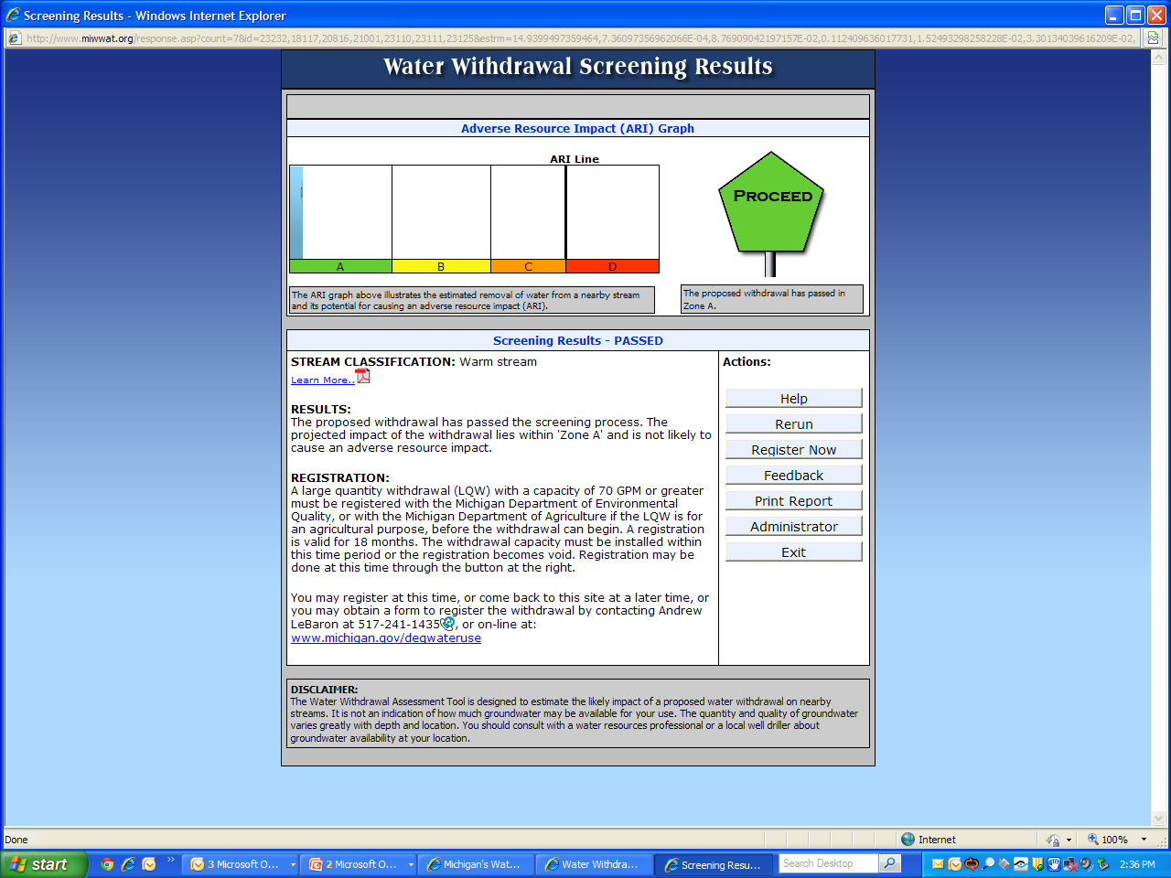

Slide 33
Key Components to Success
Consistent with the Clean Water Act
Based on sound science and data
Monitoring and assessing
Adaptive management
Collaborative approaches.
Innovative approaches.

Slide 34
Questions?

